Slide 1

Sustainable Mobility Tracker: Car Metrics Calculator
SRM INSTITUTE OF SCIENCE AND TECHNOLOGY
SCHOOL OF COMPUTING
DEPARTMENT OF COMPUTING TECHNOLOGIES
18CSP107L / 18CSP108L - MINOR PROJECT / INTERNSHIP
Batch ID: B297
Student 1 Reg. No: RA2011003011063
Student 1 Name: Samanyu B Rao
Student 2 Reg. No: RA2011003011089
Student 2 Name: Smit Vichare
Guide name: Mrs. S. Kanmani
Designation: Assistant Professor Department: Department of Computing Technologies

Slide 2
ABSTRACT
This study addresses the crucial role of adequate CO2 levels in supporting vegetation and ecological balance. However, excessive CO2 emissions from industrial sources and transportation, including land, space, and oceanic vehicles, contribute significantly to the greenhouse effect, global warming, and climate change.
The focus here is on the concern over CO2 emissions from vehicles, particularly cars, and the importance of accurate predictive models for forecasting these emissions.
This work proposes the implementation of four prediction models – Linear Regression, Ridge Regression, Lasso Regression, Random Forest model, Neural Network model and Elastic Net Regression - alongside existing models to enhance the accuracy of forecasting CO2 emissions and guide effective strategies for mitigation.

Slide 3

INTRODUCTION
Our project introduces a web-based application developed using the Flask framework, aimed at predicting and comparing fuel consumption and CO2 emissions of various vehicle models. Leveraging machine learning models, including linear regression, ridge regression, lasso regression, Random Forest model, Neural Network model and elastic net regression, this application provides users with the ability to estimate fuel consumption and CO2 emissions based on user-specified input parameters.

Slide 4
LITERATURE SURVEY
The current systems in place used to predict carbon emissions for upcoming under-development vehicles use three different methods:
Mathematical formulae
Simple standalone Linear Regression Model
Simple standalone Random Forest Regression Model
These existing models are not as accurate for different variations of parameters used in calculating carbon emissions and fuel efficiency. The mathematical formulas provide theoretical values of emissions that can vary drastically from the actual emissions recorded. Therefore, it is of great importance to develop a model that addresses these.

Slide 5
GAP IDENTIFICATION
The algorithms used in existing systems could be further optimized and in some cases be replaced with better and more efficient algorithms.
Current systems lack the usage of models like Ridge Regression, Lasso Regression, Random Forest Model, Neural Network Model and Elastic Net Regression which can provide optimal solutions for the problem.
The margin for error is existing systems is very high and can reduced by adding more systems to account for accuracy of the problem.
Addition of more modules can help us receive more realistic results for the given systems.

Slide 6
Problem statement:
In Predictive models for Co2 Emission, the current systems are confronted with inefficiencies in algorithm usage, missing essential regression models (like Ridge, Lasso, random forest, neural network and Elastic Net), and a substantial margin for error, all of which hinder the achievement of accurate results. The problem at hand is to enhance the existing systems by optimizing algorithms, incorporating the missing regression models, and reducing the margin for error to improve the accuracy of Co2 Emission Predictive models.
Objective:
1. Enhancing Predictive Models for CO2 Emission Forecasting: This study aims to address the existing gap in predictive modelling for vehicle-related CO2 emissions. It proposes the implementation of four distinct prediction models: Linear Regression, Ridge Regression, Lasso Regression, and Elastic Net Regression. These models are intended to provide more precise forecasts of CO2 emissions from vehicles, thereby contributing to a better understanding of emission patterns.
2. Guiding Effective Mitigation Strategies: By improving the accuracy of CO2 emission forecasts, the study seeks to offer valuable insights for decision-makers, policymakers, and environmental agencies. The enhanced predictive models can assist in anticipating and planning for future CO2 emissions from vehicles, facilitating the development of targeted and efficient strategies for emission reduction and mitigation. This objective aligns with the broader goal of minimizing the adverse environmental impacts of CO2 emissions and fostering sustainable practices.

Slide 7
DATASET USED
This dataset captures the details of how CO2 emissions by a vehicle can vary with the different features. The dataset has been taken from Canada Government official open data website. This is a compiled version. This contains data over a period of 7 years. There are few abbreviations that has been used to describe the features. They are listed Below. The same can be found in the Data Description sheet:
Model: 4WD/4X4 = Four-wheel drive, AWD = All-wheel drive, FFV = Flexible-fuel vehicle, SWB = Short wheelbase, LWB = Long wheelbase, EWB = Extended wheelbase.
Transmission: A = Automatic, AM = Automated manual, AS = Automatic with select shift, AV = Continuously variable, M = Manual, 3 - 10 = Number of gears.
Fuel type: X = Regular gasoline, Z = Premium gasoline, D = Diesel, E = Ethanol (E85), N = Natural gas.
Fuel Consumption: City and highway fuel consumption ratings are shown in litres per 100 kilometres (L/100 km) - the combined rating (55% city, 45% hwy) is shown in L/100 km and in miles per gallon (mpg).
CO2 Emissions: The tailpipe emissions of carbon dioxide (in grams per kilometre) for combined city and highway driving
Dataset Link: https://open.canada.ca/data/en/dataset/98f1a129-f628-4ce4-b24d-6f16bf24dd64#wb-auto-6

Slide 8
ALGORITHMS USED
Model | Description | Use Cases | Advantages | Disadvantages
Linear Regression | Simple linear modeling without regularization. | - When there's no multicollinearity | - Easy to interpret and implement | - Sensitive to outliers
Ridge Regression | Linear regression with L2 regularization. | - When multicollinearity is present | - Reduces overfitting | - All features are retained
Lasso Regression | Linear regression with L1 regularization. | - Feature selection, sparse datasets | - Feature selection (sets some coefficients to zero) | - May not work well with highly correlated features
Elastic Net Regression | Combination of L1 and L2 regularization. | - When both Lasso and Ridge are needed | - Balances feature selection and overfitting | - Requires tuning of hyperparameters
Random Forest
Neural Network
Notes:
L2 - adds “squared magnitude” of coefficient as penalty term to the loss function.
L1 - adds “absolute value of magnitude” of coefficient as penalty term to the loss function.
Multicollinearity is a statistical concept where several independent variables in a model are correlated.

Slide 9
PROPOSED SYSTEM
The proposed system outlined in this study focuses on the development and integration of advanced predictive models to enhance the accuracy of forecasting carbon dioxide (CO2) emissions from vehicles, along with calculating fuel efficiency. With a primary emphasis on cars, the system is structured around the following integral components:
1. Data Collection and Preprocessing:
Aggregate comprehensive and diverse datasets encompassing vehicle attributes, usage patterns, fuel types, driving conditions, historical emission data, and fuel consumption metrics.
Employ meticulous data cleaning and preprocessing procedures to rectify outliers, address missing values, and ensure the uniformity and integrity of the collected data.
2. Predictive Model Integration:
Implement four distinct prediction models: Linear Regression, Ridge Regression, Lasso Regression, random forest, Neural network and Elastic Net Regression.
Train and fine-tune these models using the meticulously pre-processed dataset, establishing robust relationships between vehicle-related parameters, CO2 emissions, and fuel efficiency.

Slide 10
PROPOSED SYSTEM
3. Model Evaluation and Selection:
Utilize evaluation metrics including Mean Squared Error (MSE), Root Mean Squared Error (RMSE), R-squared, and custom metrics for fuel efficiency assessment.
Selecting the most suitable model based on its consistent ability to provide accurate CO2 emission forecasts and reliable fuel efficiency calculations.
4. Enhanced Forecasting and Mitigation Strategies:
Generate precise and reliable projections of future CO2 emissions and fuel efficiency measures using the selected predictive model.
Integrate model outputs into existing environmental impact assessment to guide effective mitigation strategies and informed policy decisions.
5. Mitigation Strategy Recommendations:
Utilize the selected predictive model to generate precise projections of future CO2 emissions and fuel efficiency measures from vehicles.
Decreasing error rates with enhanced predictive models.

Slide 11
PROPOSED SYSTEM
6. User Interface and Visualization:
Develop an intuitive interface catering to stakeholders, policymakers, and decision-makers, enabling direct interaction with the predictive model and access to emission forecasts and fuel efficiency insights.
Utilize advanced data visualization to effectively present emission trends, scenario analyses, and potential impacts of various mitigation measures.
7. Continuous Model Refinement:
Establish an iterative refinement process to ensure predictive models remain accurate by incorporating newly available data and adapting to evolving vehicle technologies and trends.

Slide 12
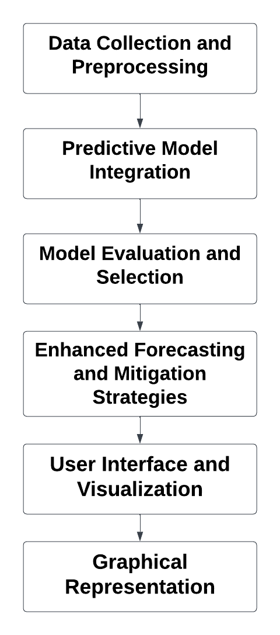
Architecture/Block Diagram of the proposed model:

Slide 13
MODULES DESCRIPTION
Module 1: Data Collection and Preprocessing:
Input: Engine size, Cylinders, Fuel Consumption
Output: Function Parameters
Gather diverse datasets including vehicle attributes, usage patterns, fuel types, driving conditions, historical emission data, and fuel consumption metrics.
Clean and preprocess the data to handle missing values, outliers, and ensure data quality and consistency.
Transform the data into a suitable format for analysis and modelling.
Module 2: Predictive Model Integration:
Input: Function Parameters
Output: Function calculated results
Implement four distinct predictive models: Linear Regression, Ridge Regression, Lasso Regression, random forest, Neural network and Elastic Net Regression.
Train and fine-tune these models using pre-processed data to establish robust relationships between vehicle parameters, CO2 emissions, and fuel efficiency.
Ensure models accurately forecast emissions and calculate fuel efficiency.

Slide 14
MODULES DESCRIPTION
Module 3: Model Evaluation and Selection
Input: Function results of all available models
Output: Most accurate choice from results
Employ various evaluation metrics including MSE, RMSE, R-squared, and custom metrics for fuel efficiency.
Evaluate model performance to identify the most accurate model for generating CO2 emission forecasts and fuel efficiency calculations.
Module 4: Enhanced Forecasting and Mitigation Strategies
Input: Comparison with error rate with resultant values
Output: Final resultant reading
Utilize the selected predictive model to generate precise projections of future CO2 emissions and fuel efficiency measures from vehicles.
Decreasing error rates with enhanced predictive models.

Slide 15
MODULES DESCRIPTION
Module 5: User Interface and Visualization
Input: Final resultant reading
Output: Final Co2 emission reading
Develop an intuitive interface for stakeholders, policymakers, and decision-makers to interact with the predictive model and access emission forecasts and fuel efficiency insights.
Employ data visualization to communicate emission trends, scenario analyses, and potential impacts of mitigation measures effectively.
These five modules encompass critical components for creating a comprehensive system to accurately forecast CO2 emissions, calculate fuel efficiency, and inform impactful mitigation strategies for vehicles.

Slide 16
Intermediate Results and Discussion
Implementation of Linear Regression, Ridge Regression, Lasso Regression, Random Forest, Neural Network and Elastic Net Regression Models has been done successfully.
Prediction of carbon emission has been done using these trained models, along with error rate prediction.
Graphical Representation of fuel efficiency of various car models has been displayed with respect to their companies.
Comparison between two different model have been established in terms of Features/Parameters.

Slide 17
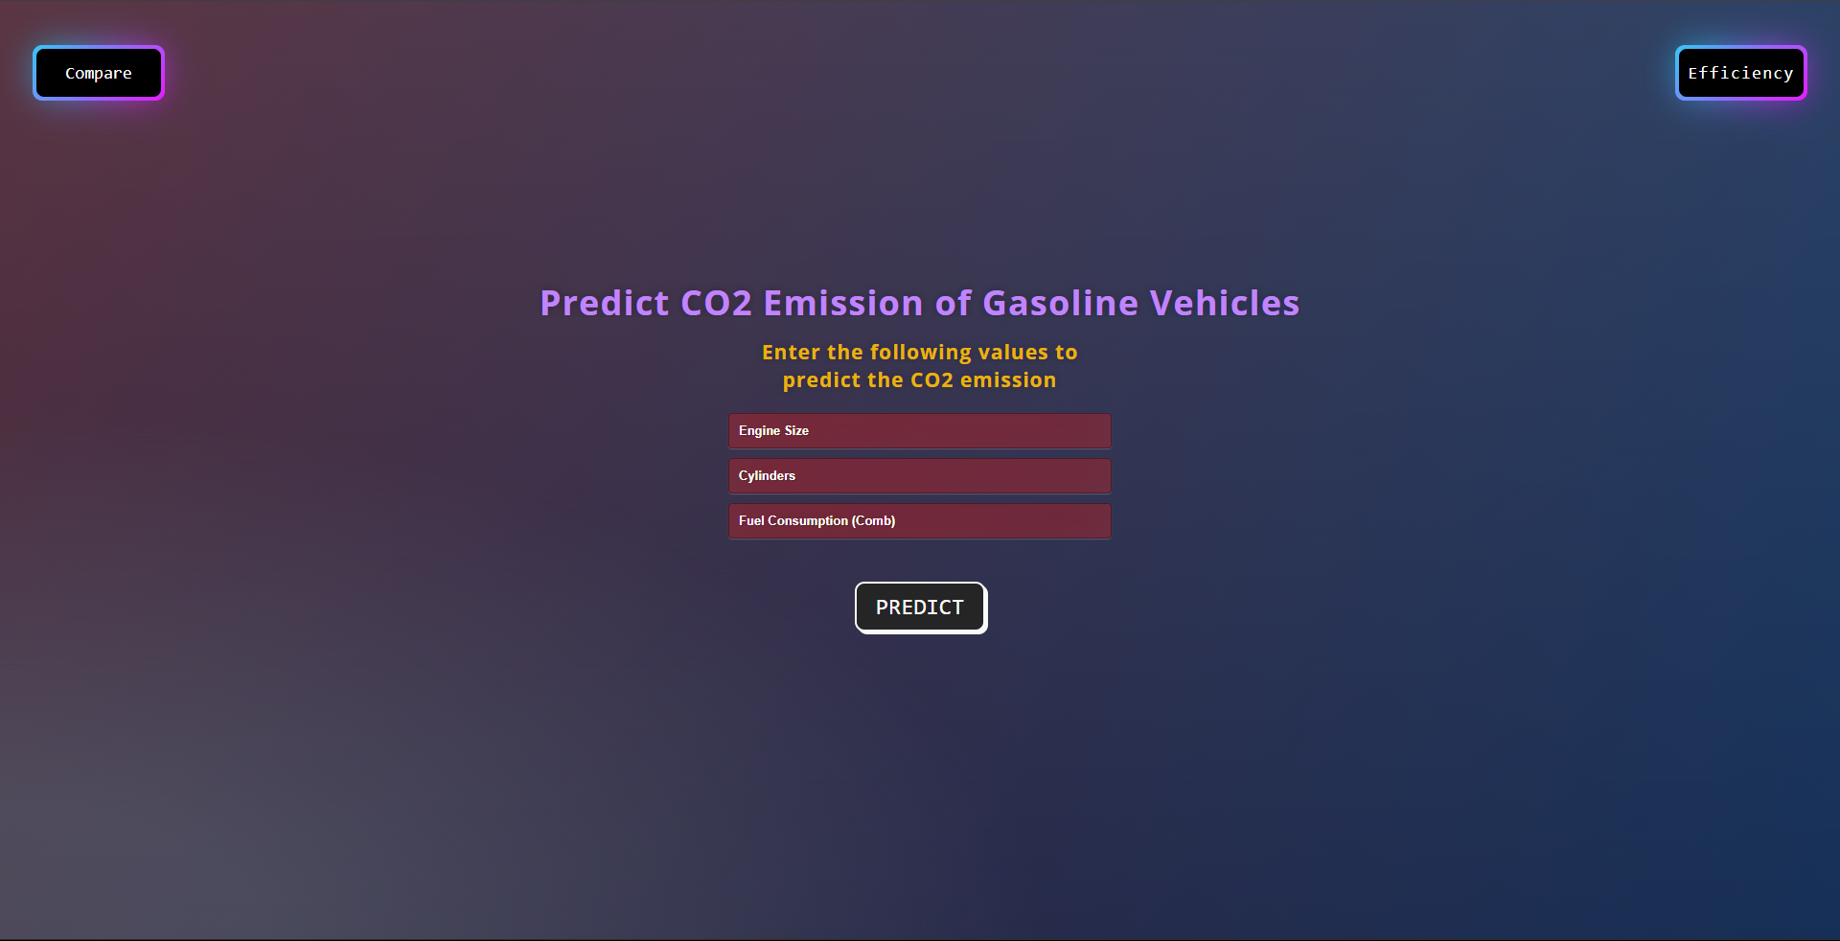

Slide 18
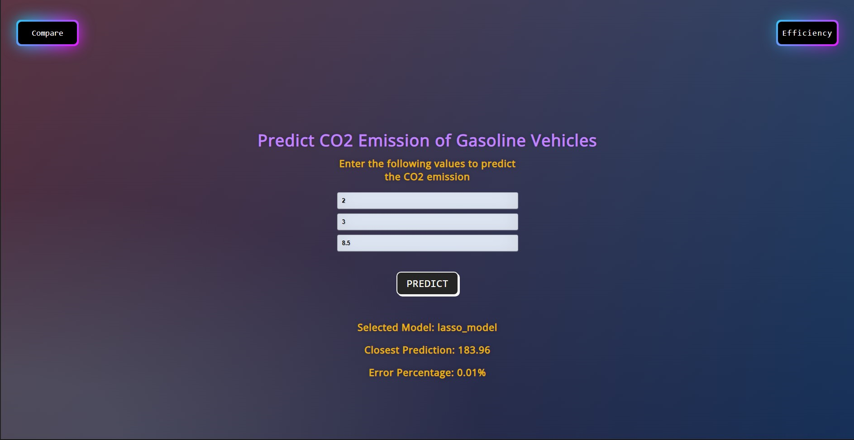

Slide 19
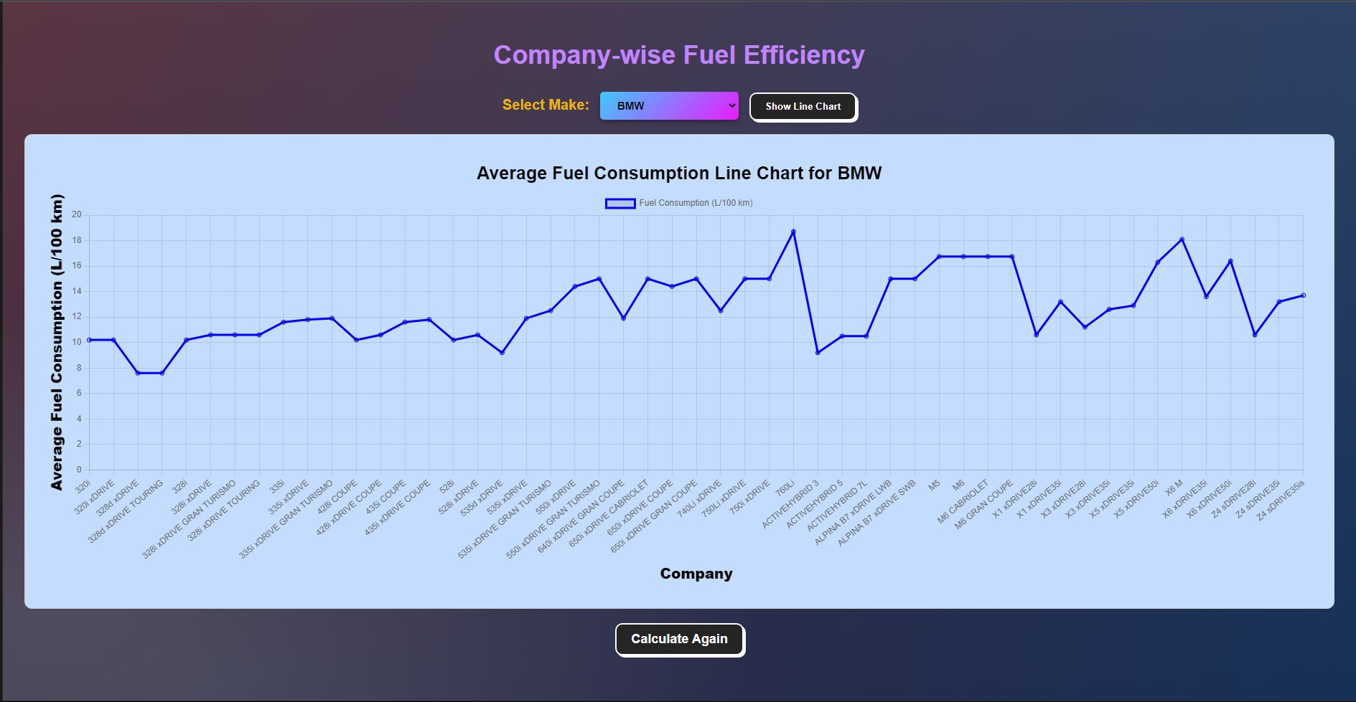

Slide 20
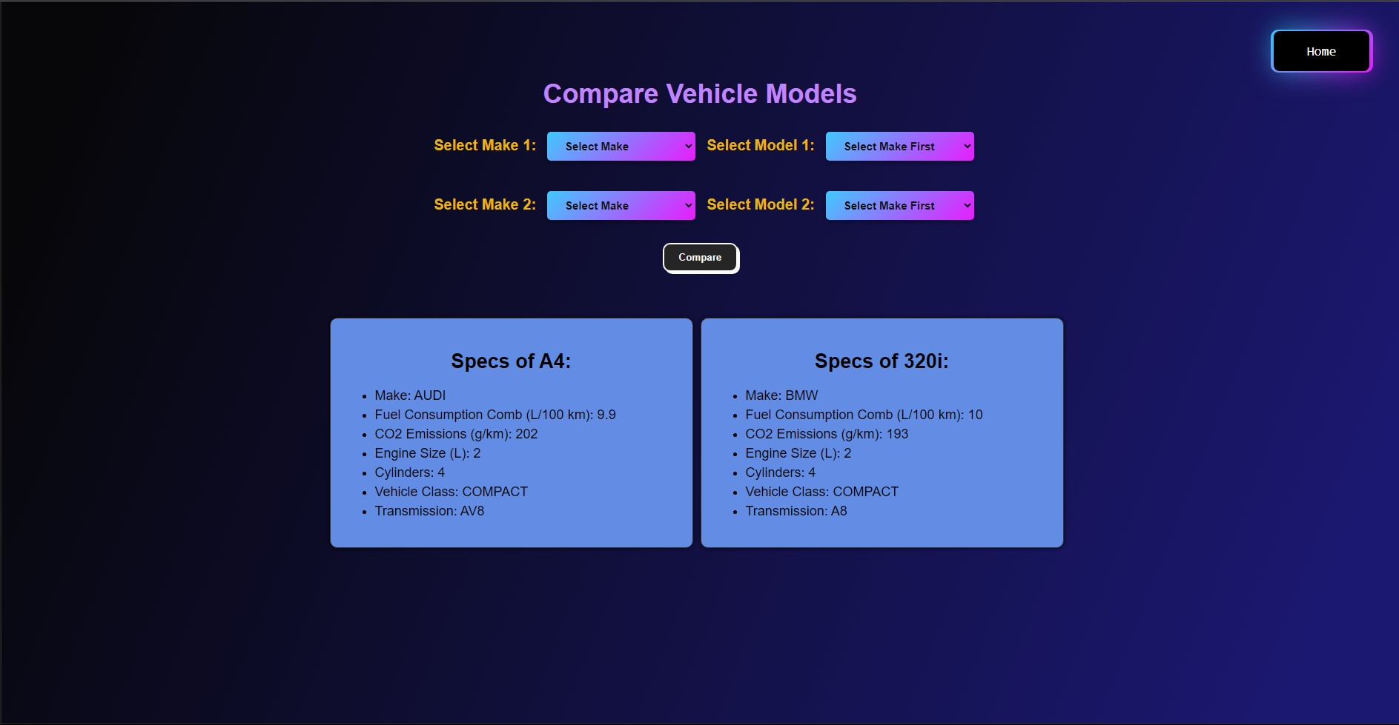

Slide 21
References
https://www.mdpi.com/2073-4433/13/11/1871
https://www.kaggle.com/code/drfrank/co2-emission-eda-visualization-machine-learnin/input
https://open.canada.ca/data/en/dataset/98f1a129-f628-4ce4-b24d-6f16bf24dd64#wb-auto-6

Slide 22
Questions?

